Slide 1
Operational Governance
Accelerating trade cycles
March 2023

Slide 2



Speakers
A talk by practitioners, for practitioners
Stephen Goldbaum
Distinguished Engineer
Ephrim Stanley
Technology Fellow
Antoine Amend
Sr Technical Director - Industry Solutions

Slide 3
“Nothing Good Happens between Trade and Settle Date”
Notes:
More of an adage than a quote, we’ve heard that say in the street when moving from T3 down to T2 back in … 2015. Time equals risk, and reducing that time means reducing the number of trades that fail. In the past few years, needless to say we observed period of high volatility, so reducing that time even further makes perfect sense.
Surely, in an era of technology and AI, it should not be difficult.
we’ve seen a global pandemic, environmental challenges, climate risk awareness, the rise of retail investment, meme stocks.. We’ve seen an explosion of data that exposed clear limitations of post trade systems ability to adapt, scale.
But keeping around End-of-Life system software and aging computer systems in general?

Slide 4


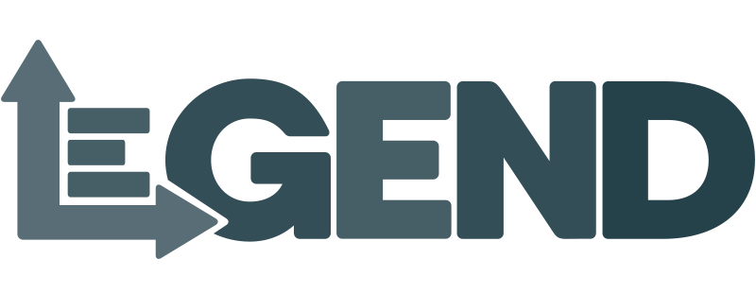
Shortening Trade Cycles
Streamlining operations through open source initiatives
Motivations
Create a frictionless system between market participants
Reduce risks for periods of high volatility, hence margins
Standards
Challenges
Back offices are known for legacy systems and data silos
Transfer of information requires tedious reconciliation
Interoperability
Collaboration
Solutions
Machine interpretable data and calculation
Harmonization of data across organizations
Notes:
Suggested by DTCC, T1 now enforced by the SEC to take place by mid 2024. That leaves us with only a year to build, integrate and test, not 1, 2, 5 systems, but an ecosystem shared with each market participant, from buy side, sell sides, custodians, clearing houses. But modernizing does not just means complying. When NCC margin calls are estimated to be reduced by 40%, that’s billions of dollars that could be reinvested elsewhere should we streamline that process between back and front office.
Back offices are notoriously known for silos across regions, trading desks, and asset classes, legacy technologies, manual processes. I would not be surprised to hear some teams running from one system to another with a floppy disk or sending the same via fedex courier. Simple, we ask them to run 2 times faster now.
Or we can realize that it is not about running faster, but running smarter. It’s not about lifting and shifting the existing technology to faster horses, but adopting a new behavior, a new approach to data. Allowing data, processes and calculations to be machine interpreted through simple interfaces (i.e. contracts), by connecting data modelling to data pipelines, compliance requirements to data operations, connecting business with technology. This shift is exactly in line with the core principles behind open source technologies and what we observe with data forward companies. They do not just comply, they win.

Slide 5
Questions for Stephen
What is Morphir, and what were the motivations behind this initiative?
Why making it open source?

Slide 6
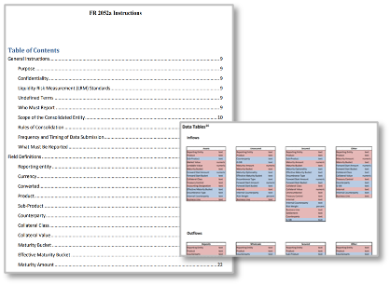
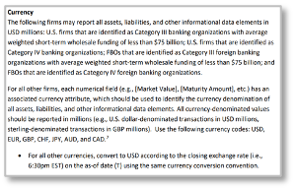
Morphir
Logic as a machine interpretable contract
Morphir is composed of a library of tools that facilitate the digitisation of business logic into multiple different languages & platforms.
Ensure it’s correct
Understand the whole regulation
Future proof
Collaborate across industry, vendors, and regulators
Interpret
Document
Test
Implement
1
2
3
4
Notes:
What is Morphir?
What was the motivations behind Morphir?
Why making it open source?

Slide 7
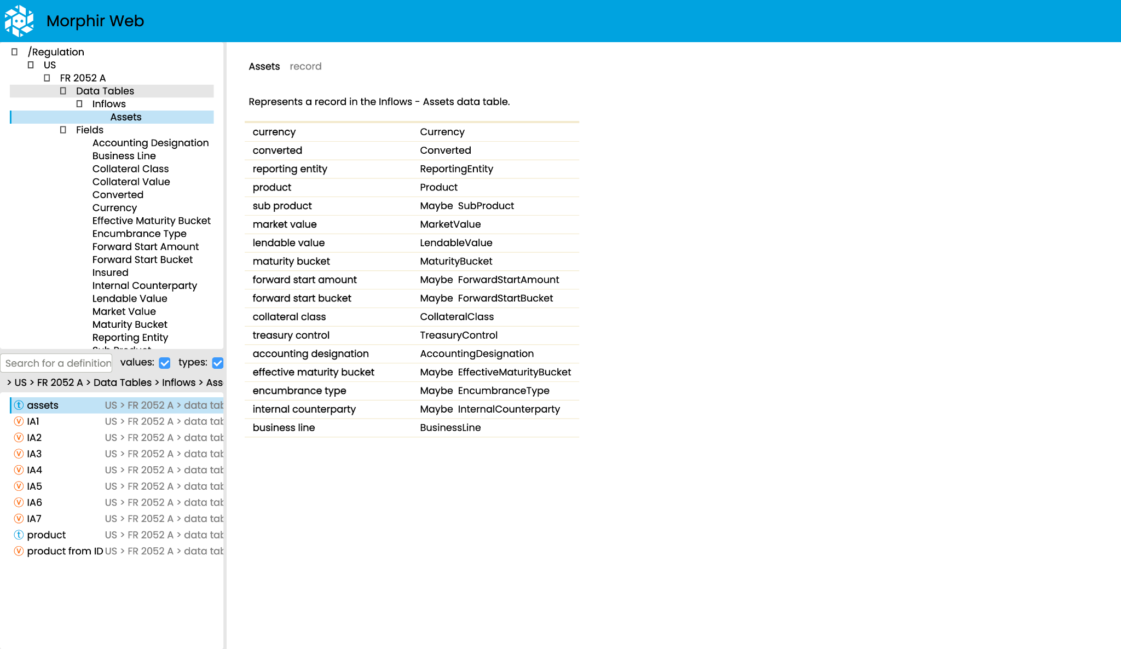

Slide 8
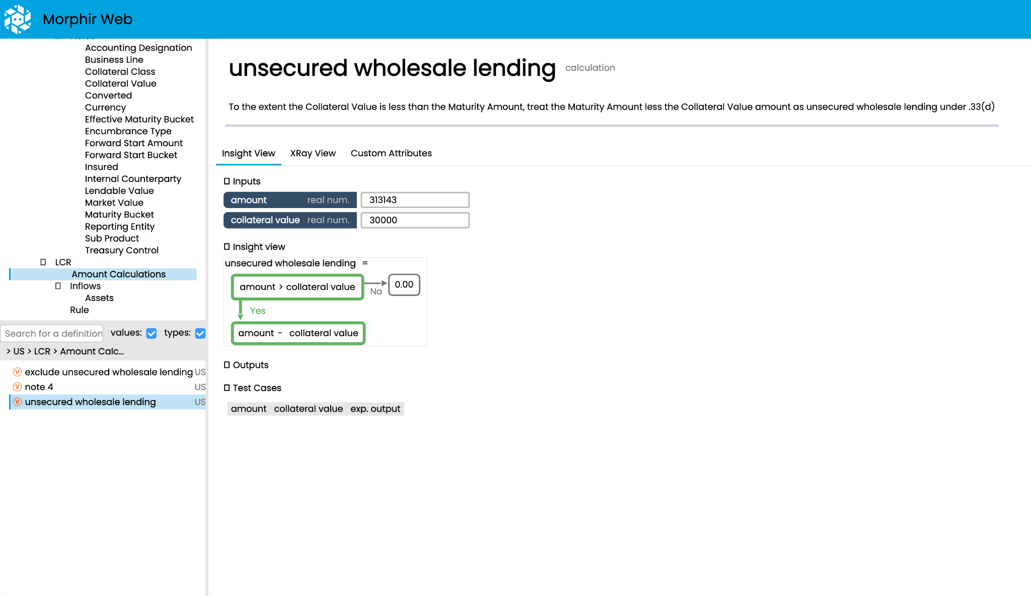

Slide 9
Questions for Stephen
Morphir can interpret business logic as code. What makes Morphir special to run with Databricks?
Appreciate if answer can be articulated around operation efficiency and reducing cost of ownership. The goal of Morphir is to connect end user with technology, not to rely on additional ops team to maintain complex infrastructure, shutting down / starting up, configuring clusters.
How would you see this partnerships moving forwards?
Appreciate if answer can be around delta sharing capabilities. The goal is not to automate creation of reports but make those reports actionable, hence connecting them back to end users. Partnerships around to ensure E2E governance from data sourcing, report execution all the way to data access.

Slide 10
Questions for Ephrim
What is Legend, and what were the motivations behind this initiative?
Why making it open source?

Slide 11
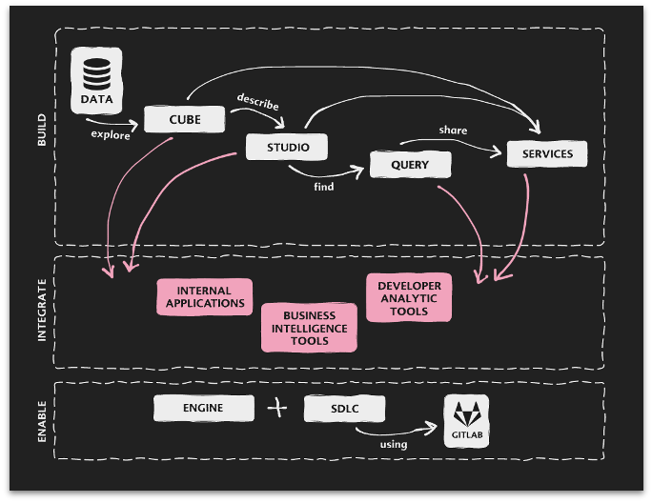
Legend
Data as machine interpretable models
Legend is a data modeling and management platform. A data model is a systematic way of describing business concepts and their relationships.
Data is physically stored in platforms like Databricks. Legend enables a logical model to be mapped to the underlying physical model.
Using this mapping, Legend converts a logical query to a physical query. This enables users to get a consistent view of the (logical) data irrespective of where data is stored (physical).
Notes:
What is Legend?
What was the motivations behind Legend?
Why making it open source?

Slide 12
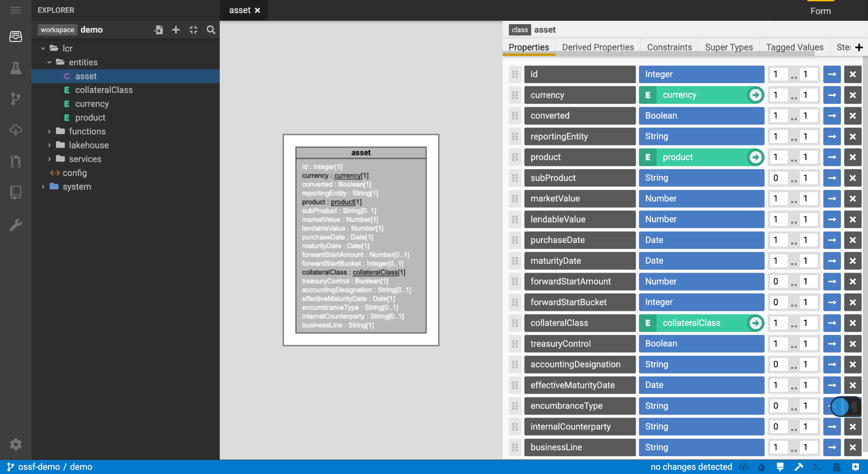

Slide 13
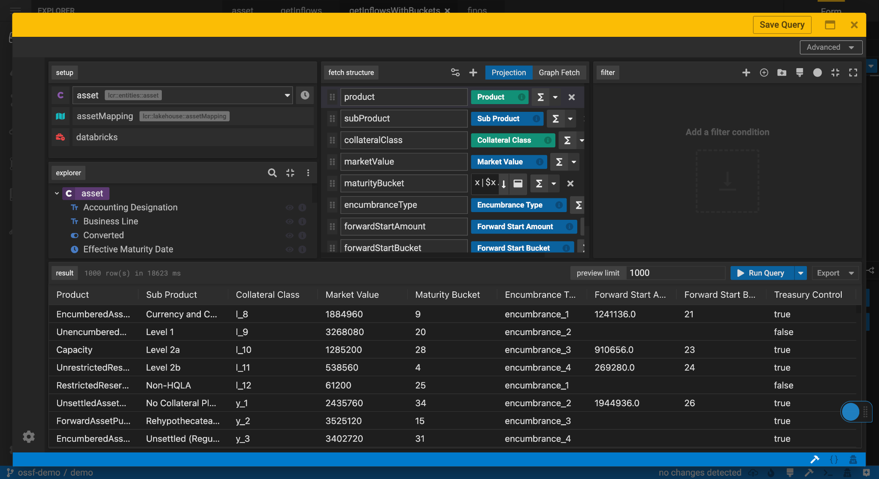

Slide 14
Questions for Ephrim
The secret behind legend is its ability to leverage multiple technologies consistently. Using the right tech for the right purpose. What makes legend special to run with Databricks?
Appreciate if answer can be around data processing capabilities (above and beyond data querying capability) so that data can be embedded into core operation pipelines and complex data ingestion processes.
How would you see this partnerships moving forwards?
Legend Delta contribution is just the start. We can discuss roadmap around legend services, SQL protocol, spark execution planner, etc. The importance of open source across different organizations. Sharing models with legend depot, sharing data with databricks.

Slide 15
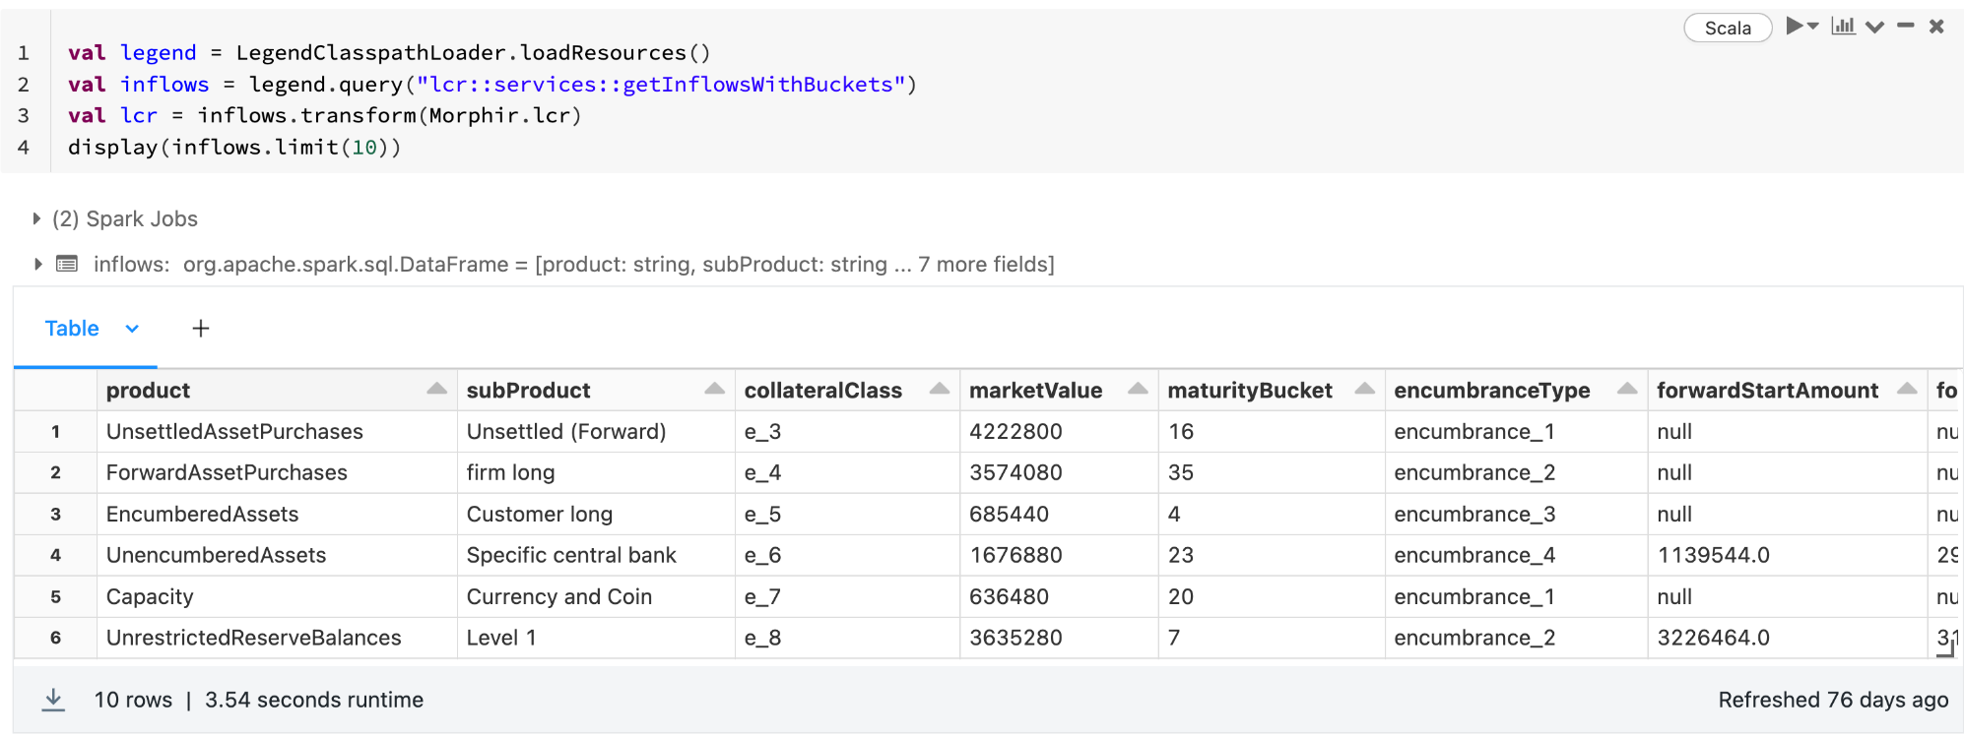

Slide 16





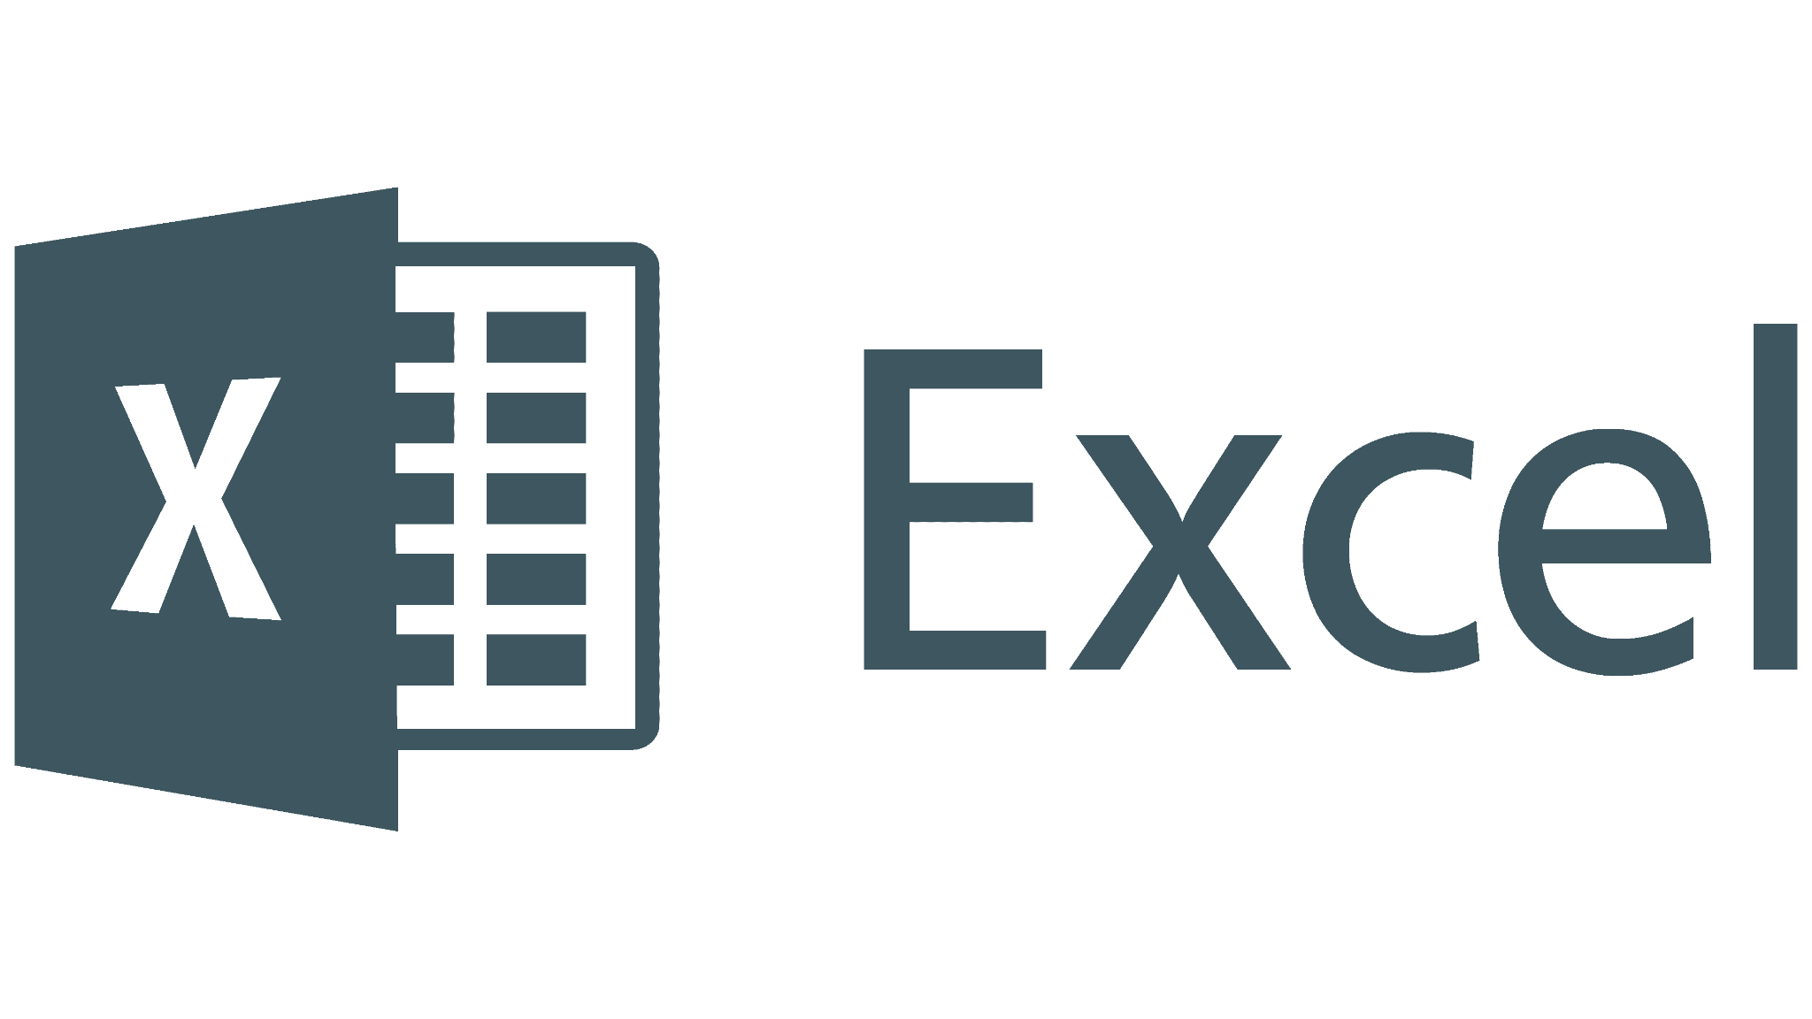


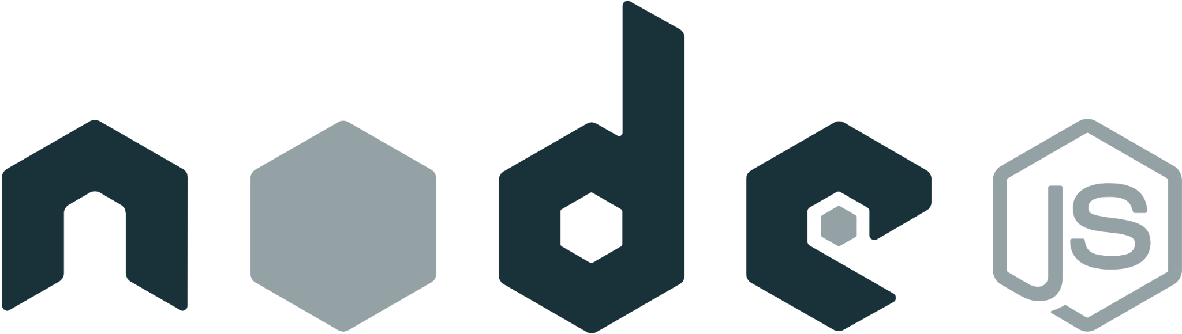

Openness unlocks interoperability
Interoperability unlocks automation
Data is accessible as-is through BI and enterprise FS frameworks.
Data, code and models follows SDLC best practices, unlocking reusability.
Enabling interoperability of insights without transferring information.

Slide 17












Lakehouse for Financial Services
Industry solutions
addressing industry use cases
ingest & curate industry datasets
Solution accelerator
Data ingestion
solution accelerators
Regulatory reporting
B-PIPE connector
Solution enablers
Solution accelerator
Data ingestion
ESG investing
Document digitization
DATA LAKEHOUSE
Solution accelerator
Data processing
Brickbuilder solutions
Value at risk calculation
TEMPO library
Process, manage, and query all of your data.
Delta sharing partners
Providers
Mainframe augmentation
Data providers
Data connectors
Providers
Risk management
Solution blueprints
enabling access patterns
Data connector
LEGEND framework
automate deployment of data ecosystem
Terraform deployment
Data connector
Security and governance
MORPHIR framework
Industry data model
Data connector
ISDA CDM
Delta sharing excel plugin

